Slide 1
ClimbCode
Notes:
Welcome to ClimbCode’s exposition. Here we’ll see the results of the development’s first sprint of this project.

Slide 2

Our Path Today
Idea
The Workgroup
Business Plan
Technologies
Status
2
Notes:
The main points we’re going to talk about are the following ones: First, we’ll talk about the idea that ClimCode represents. Next, we’ll introduce the team which is developing the project. Then, we’ll skip to the business plan that will begin to be applied in the next sprint. Then, we’ll see the technologies we’re using in the project, their situation and their assigned members. Finally, we’ll see the status of the project this week.

Slide 3
Idea
Notes:
We’ll start seeing which idea lies behind ClimbCode. But first, let me introduce two facts:

Slide 4
"Let us think of education as the means of developing our greatest abilities"
J.F.K.
4
Notes:
The first one is, as we see here, that education is the means of developing our greatest abilities. We’re sure that we all agree in that by education and learning is how we develop ourselves and become better, right?

Slide 5
"Software’s function is to make the complex, simple"
Grady Booch
5
Notes:
The second one is that the software’s function is to make the complex, simple. Seeing the upgrades made to natural processes by the software, it’s logical to think this too, isn’t it?

Slide 6

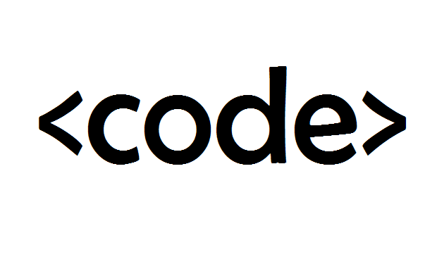
Idea
+
=
ClimbCode
6
Notes:
Then what would happen if we combined those two concepts: Education and Software? The answer to this is ClimbCode, our web platform, which acts as a supporting tool for teaching with the help of programming and software.

Slide 7


MVP & Business
Interactive
7
Notes:
How do we grant this support? Simple, by interactive exercises, a better version of the original paper exercises made by independent programmers. Those exercises are bought by schools in order to increase their content catalog they have for supporting their subjects.

Slide 8

Learn Programming?
8
Notes:
But then, is it imperative to know programming to use our platform as a school? Of course not! Our interactive exercises are ready to use for teachers and students without any programming knowledge.

Slide 9
The Workgroup
Notes:
Once we’ve seen what we have in our hands, these are the seven people behind ClimbCode’s development:

Slide 10


The Workgroup
Alejandro Román Rodríguez
Project Manager
Álvaro Domínguez Núñez Business Manager
10
Notes:
Alejandro Román, the project manager, Álvaro Domínguez, the business manager…

Slide 11

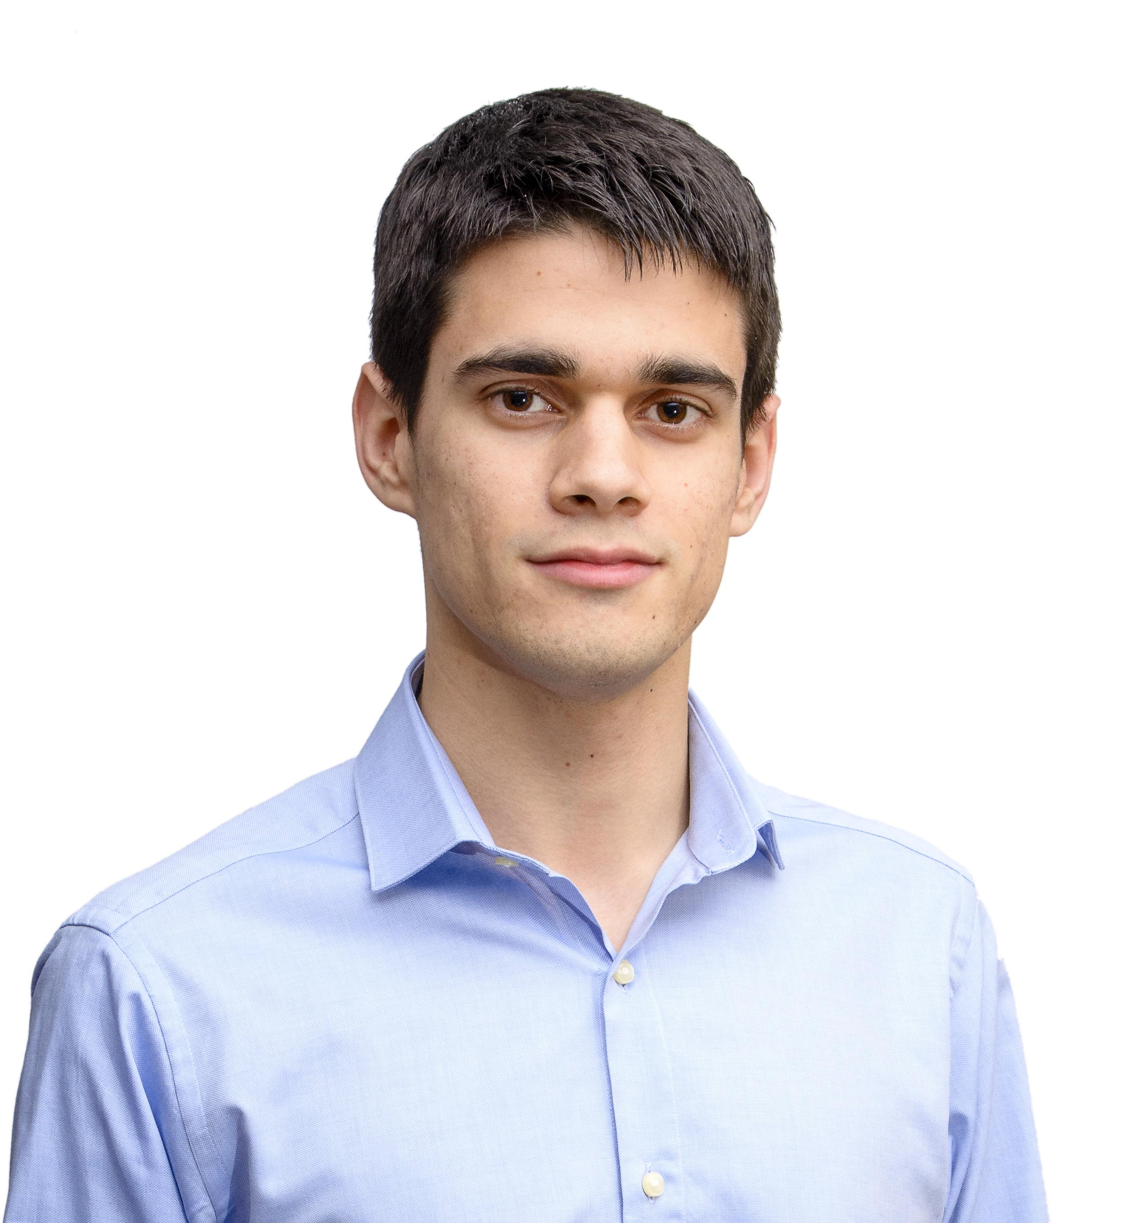
The Workgroup
Miguel Ángel Baños Carretón Front-End Developer
Alejandro Garrido Resina
Front-End Developer
11
Notes:
Our front-end developers: Miguel Ángel Baños and Alejandro Garrido…

Slide 12

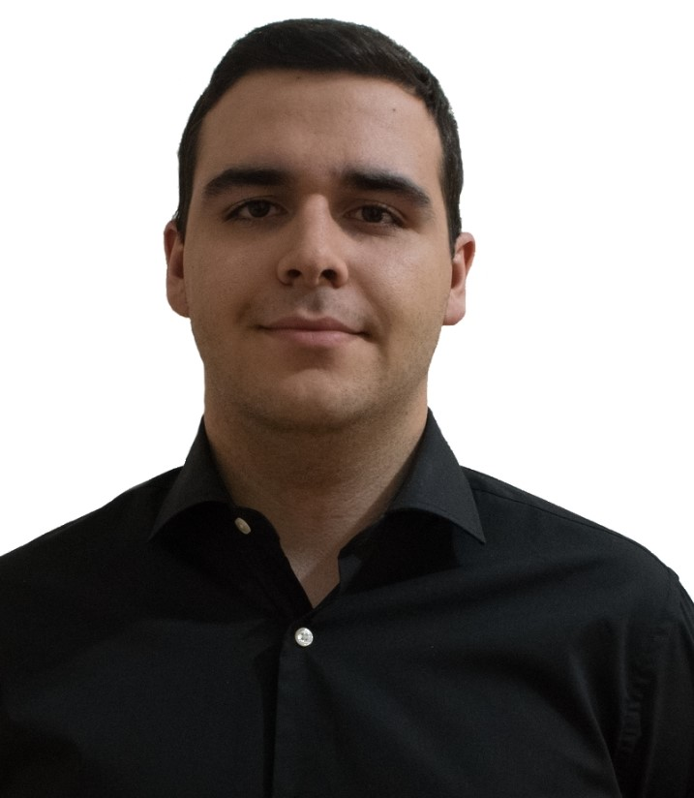
The Workgroup
Andrés Fernández Alés
Back-End Developer
Álvaro Sánchez López
Back-End Developer
12
Notes:
And our back-end developers: Andrés Fernández, Álvaro Sánchez…

Slide 13
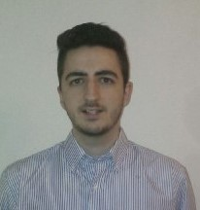
The Workgroup
Jesús Sosa Sánchez Back-End Developer
13
Notes:
And Jesús Sosa. These are the seven members of the workgroup.

Slide 14
Business Plan
Notes:
Now we go straight to the business plan of the project.

Slide 15

Business Plan
1: Survey for programmers
15
Notes:
Due to the need of initial content for ClimbCode in matters of interactive exercises, we’ve set a business plan based in two phases, each of them having three steps. In the first phase, having the interactive exercises’ creation system built, we will focus in programmers, trying to reach them and having them as potential content creators. In order to do so, first we’ll make a survey asking them how much effort would they spend creating content if they could earn money with it, and what do they think about the means of doing so.

Slide 16

Business Plan
2: Meeting with programmers
16
Notes:
Then, we’ll proceed with a meeting with a group of these programmers, showing them how the interactive exercises’ creation system works, and receiving feedback from them in order to upgrade it to their possible needs.

Slide 17

Business Plan
3: Survey for schools
17
Notes:
After finishing this first phase, and once we’ve developed the whole first version of our interactive exercises’ system allowing them to be stored in our database, we’ll star the second phase of our plan. In this one, we’ll first make another survey, this time for schools and teachers, asking them about their means for doing exercises in their lessons, if they would like a more automatic way for doing so and the impact they think it would have in the students.

Slide 18

Business Plan
4: Meeting with schools
18
Notes:
Once the survey is completed, we will meet with many possible teachers, showing them how the execution of our interactive exercises works and receiving feedback for them.

Slide 19

Business Plan
5: Repeat 2 & 4
19
Notes:
Finally, and while we have time for it, we will repeat the meetings mentioned in both phases, in order to get more feedback from our changes, and more possible customers for our product.

Slide 20
Technology
Notes:
Now we’ll see the technologies we’re using to develop ClimbCode.

Slide 21




Technology
Development:
21
Notes:
For the main development of our project, we’re using PostgreSQL, Django and Python for our back-end, and Bootstrap for our front-end.

Slide 22


Technology
Deployment:
22
Notes:
For the deployment of the project, we’ve used mainly Digital Ocean, but we have an emergency version of the platform in Heroku in case that Digital Ocean isn’t available.

Slide 23



Technology
Interactive Exercises:
23
Notes:
For the interactive exercises’ system, we’re using JavaScript, with Ace for a little help with the syntax, and Chart.js for creating the graphics and pictures for the exercises.

Slide 24

Technology
Knowledge:
24
Notes:
Finally, for our knowledge management we’re using a git repository hosted in GitHub.

Slide 25
TECH. MEMBER
 | X | X
 |  |  | X
25
Notes:
The member assigned into the use of each technology are the following: Our Back-End developers are working with Python, Django and PostgreSQL, Alejandro Garrido is working with Bootstrap…

Slide 26
TECH. MEMBER
 | X
 |  | X
EVERYONE |  |  | X
26
Notes:
Miguel Ángel Baños is working with JavaScript and Ace, Alejandro Román is working with Chart.js and everyone is using the knowledge management’s technologies.

Slide 27
TECH. MEMBER
 | X
27
Notes:
And finally, Andrés Fernández and Jesús Sosa are working in our development technologies.

Slide 28
TECH. STATUS
LEARNT | X | X
LEARNING |  |  | X 80%
NOT KNOWN
28
Notes:
From those technologies, we’ve already learnt all we needed from PostgreSQL, Django and Python, and also from Bootstrap, but this one still has some non-vital features we don’t control currently.

Slide 29
TECH. STATUS
LEARNT | X |  | X
LEARNING |  | X 80%
NOT KNOWN
29
Notes:
We’ve also learnt all from JavaScript, Ace, git and GitHub and, like the previous case, only non-vital features aren’t known from Chart.js.

Slide 30
TECH. RISK
LEARNT | X | X
LEARNING
NOT KNOWN
30
Notes:
And finally, we’ve learnt all we needed from our deployment technologies, too.

Slide 31
TECH. RISK
NONE
SLOW LEARNING
LOW EXPERIENCE | X | X | X
31
Notes:
The main risks from these technologies when we started the project were the low experience the team had with them, as we see in PostgreSQL, Django, Python, Bootstrap, JavaScript and ACE. That had the danger that catching up with them could cause some delays into the project’s development. Fortunately, they didn’t.

Slide 32
TECH. RISK
NONE |  |  | X
SLOW LEARNING |  | X
LOW EXPERIENCE | X
32
Notes:
But the main risk was Chart.js, because the only thing we know about creating graphics with JavaScript was that there were plugins for doing so, so we had to start learning it from the beginning, and that learning could’ve been slow, delaying the whole main feature of our project. Fortunately it didn’t result in anything bad. Finally, the only technology that didn’t have any risks since the beginning was the one related to out knowlege management, because everyone in the workgroup was already working with it and had a lot of experience with it, too.

Slide 33
TECH. RISK
NONE
SLOW LEARNING | X
AVAILABILITY RISKS |  | X
33
Notes:
But the main risk was Chart.js, because the only thing we know about creating graphics with JavaScript was that there were plugins for doing so, so we had to start learning it from the beginning, and that learning could’ve been slow, delaying the whole main feature of our project. Fortunately it didn’t result in anything bad. Finally, the only technology that didn’t have any risks since the beginning was the one related to out knowlege management, because everyone in the workgroup was already working with it and had a lot of experience with it, too.

Slide 34
Status
Notes:
And last, but not least, we’ll talk about the current status of our project.

Slide 35

Status
0%
50%
100%
€7,8K
€29K
325 h
1120 h
Current: €27%, 29% h
Budgeted: €25%, 25% h
35
Notes:
Currently we’ve spent a total amount of XX hours and XX euros, which is a XX and a XX percent from the total, and different from the XX and XX expected this week.
(The problems which resulted in these variations will be explained later)

Slide 36
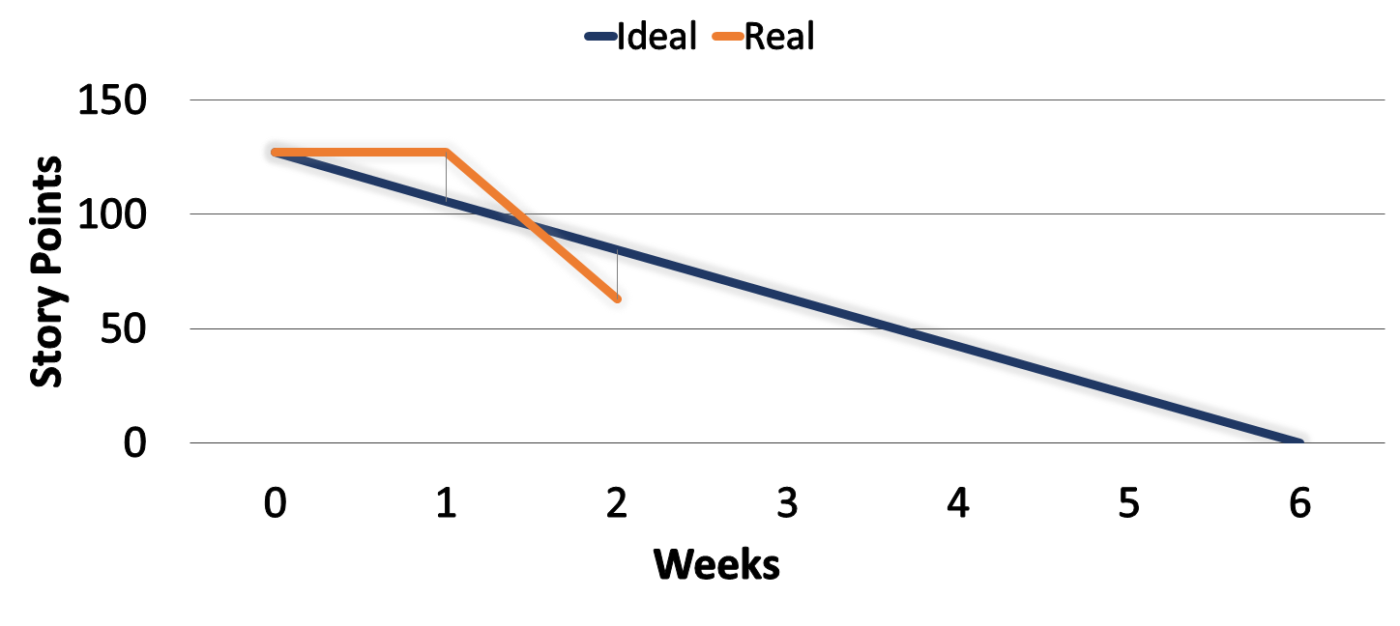
Status
36
Notes:
This investment is translated into this burndown graphic, in which we can see that we have remaining a total of 60 history points from the 130 we had in the beginning of the sprint.

Slide 37


Status
Sprint 1 (Previously):
Interactive
37
Notes:
About the features we wanted to implement this sprint, at first we wanted to combine both the main CRUDS for managing teachers, students, subjects and schools, and the creation (not storage) of exercises in the system.

Slide 38
Status
Sprint 1 (Finally):
Interactive
38
Notes:
But once we developed our business plan we realised that our focus in the development wasn’t quite right if we wanted to have good results. So, we decided to focus into the creation and execution (not storage) of interactive exercises and all the logic around them, including the management of programmers and schools instead of non-related CRUDS like the student’s or teacher’s. Doing so, we’ve achieved a full first version of the project that can be used in our business plan without any problem.

Slide 39
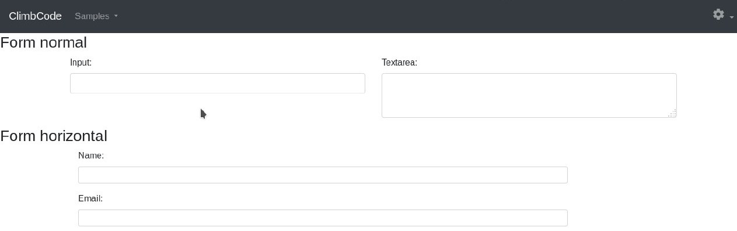
Status
HTML & CSS:
39
Notes:
Respecto al HTML y el CSS de la plataforma, hemos desarrollado una primera plantilla para ir implementando en el sistema, que iremos modificando conforme avancemos si es necesario.

Slide 40
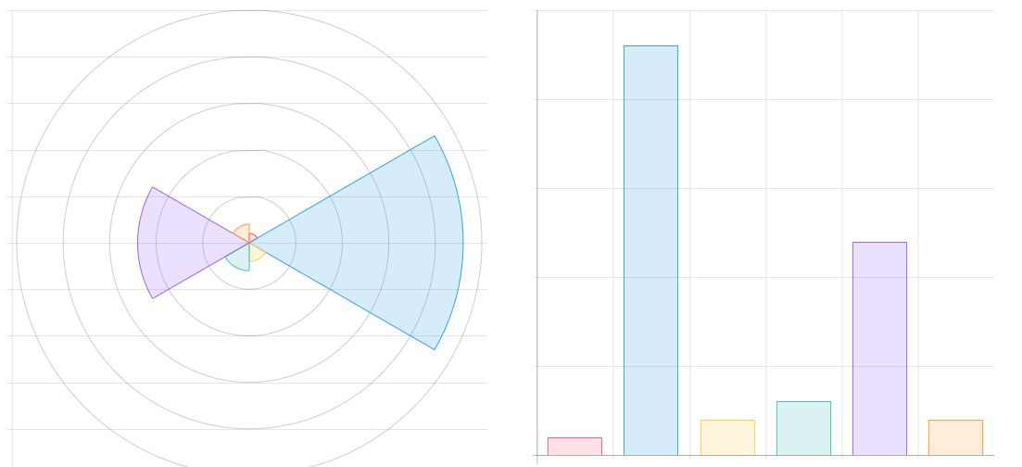
Status
Charts:
40
Notes:
En cuanto a nuestro trabajo en la parte de los ejercicios interactivos, hemos logrado hacer nuestros primeros avances en la creación de gráficas, y ya somos capaces de crear varias de ejemplo.

Slide 41
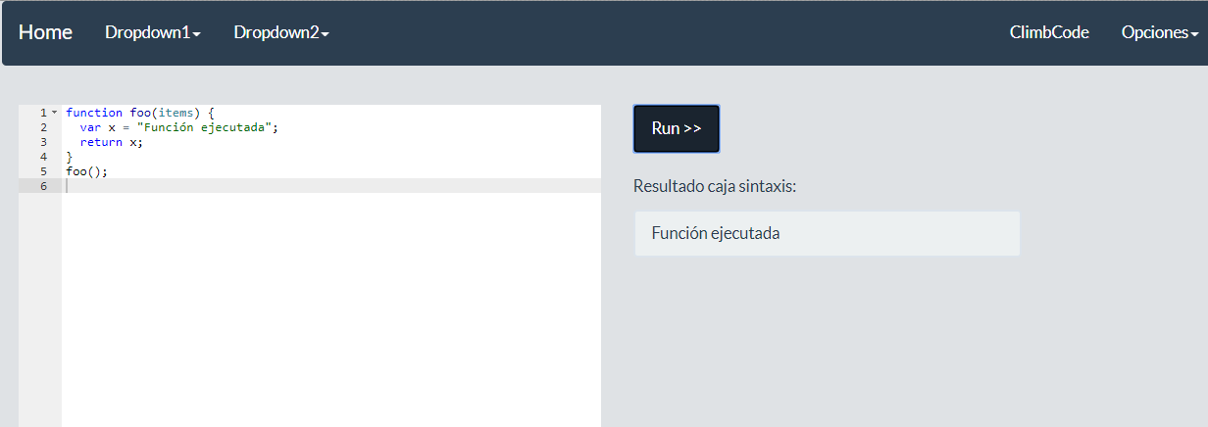
Status
Interactive Exercises:
41
Notes:
Además, hemos hecho una primera implementación de la vista de creación de ejercicios, permitiendo añadir código para ir montándolo y un botón para ejecutar el mismo y ver su resultado.

Slide 42
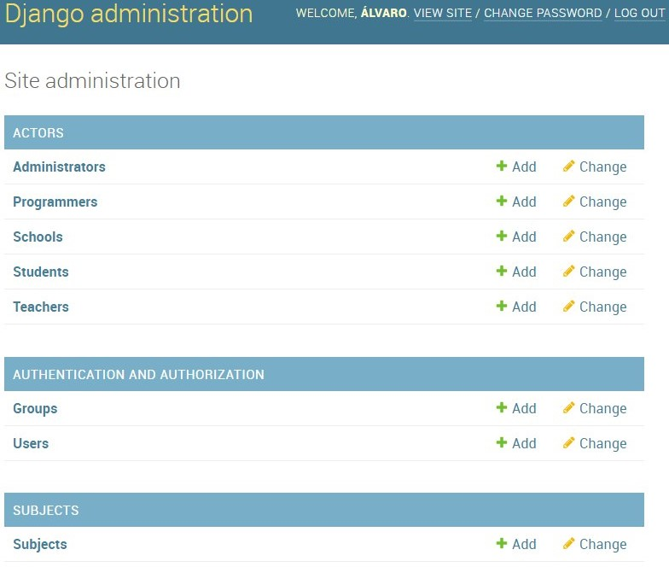

Status
42
Notes:
Por último, en cuanto a la propia estructura de la aplicación, ya hemos montado el modelo Django completo, restando solamente crear lo equivalente a vistas y controladores para tener listas las funcionalidades completas.

Slide 43


Status
EVERYONE
43
Notes:
Now speaking of the tasks made by the team all the members have participated into the meetings in order to know how was the project developing, and also into the presentation’s review.

Slide 44

TASK MEMBER
 |  | 100%
 | 100%
44
Notes:
Now, speaking task by task, our back-end developers have been working on the django model, in order to make the system navigable for creating exercises, which is completed in a hundred percent. Alejandro Garrido has been working into the main page’s style and the HTML and CSS template for our back-end developers, completing those tasks in a hundred percent, too.

Slide 45
TASK MEMBER
 | 100%
 |  | 100%
 |  |  | 100%
45
Notes:
Miguel Ángel Baños has been working into the interactive exercises’ creation system, integrating it finally in the platform with a first and fully functional version. Alejandro Román worked into the interactive exercises’ creation system, too, integrating the creation of graphics and pictures into Miguel Ángel’s work. Álvaro Domínguez has been working into the creation of this presentation. All three tasks have been finished at a hundred percent.

Slide 46


TASK MEMBER
 |  | 100% | 100%
 | 100%
46
Notes:
Álvaro Domínguez also worked into the creation of the upgrades report delivered in this deliverable, and into the creation of the business plan. Also, Andrés Fernández and Jesús Sosa worked into the deployment of the project. All tasks have been finished in a hundred percent, too.

Slide 47
TASK MEMBER
 | 100% | 100%
 |  | 100%
Design
Creation
47
Notes:
Finally, Álvaro Domínguez and Alejandro Garrido have been working on the design and creation of the first interactive exercise, seen in the previous demo.

Slide 48
The Workgroup
Alejandro Román Rodríguez
Project Manager
Álvaro Domínguez Núñez Business Manager
48
Notes:
As a summary, Alejandro Román invested a total of X hours doing X tasks completely, Álvaro Domínguez a total of X hours doing X tasks completely…

Slide 49
The Workgroup
Andrés Fernández Alés
Software Engineer
Alejandro Garrido Resina
Software Engineer
49
Notes:
Andrés Fernández invested a total of X hours in X tasks done completely, Alejandro Garrido X hours in X tasks completely done, too…

Slide 50
The Workgroup
Miguel Ángel Baños Carretón Software Engineer
Álvaro Sánchez López
Software Engineer
50
Notes:
Miguel Ángel Baños spent X hours in X tasks done at a hundred percent, Álvaro Sánchez X hours in X tasks completed the same way…

Slide 51
The Workgroup
Jesús Sosa Sánchez
Software Engineer
51
Notes:
And Jesús Sosa invested X hours in X tasks completely done, too.
That results in a total of X% of performance for each member, (exception), and means that every member has been working in his tasks, (exception).

Slide 52
Status PROBLEMAS
Next Week:
Interactive
52
Notes:
The problems that have led to this situation in terms of time, money (and performance) are XXX, which we’ve solved by XXX and will be measured by XXX from now on in order to see if those solutions have been useful.

Slide 53
Status PROBLEMAS
Next Week:
Interactive
53
Notes:
(Más espacio para errores)

Slide 54


Status
Future Sprints:
54
Interactive
Notes:
Finally, the results of this sprint will only leave us to do the transactions’ system, the storage of interactive exercises (allowing us to start the second phase of our business project) and their remaining management features, to add filters and searching methods for those exercises, and adding all the feedback we get from now on.

Slide 55

THANKS!
You can find me at
alvdomnun@alum.us.es
55
Notes:
And that’s the end of our presentation! Thank you for watching, and if you have any doubt you can contact me at alvdomnun@alum.us.es.

